Slide 1


Social Buzz Project

Slide 2


Today's agenda
Project recap
Problem
The Analytics team
Process
Insights
Summary

Slide 3

Social Buzz is the technology company to generate content over their platform by the users making them anonymous and analyse their reactions over the content. Due to the rapid growth of the content over several years the company needs the expertise of Accenture to manage and maintain their data.
The Accenture team has been assigned the three main tasks to help his client social buzz.
An audit of their big data practice
Recommendations for a successful IPO
An analysis of their content categories to highlights the top 5 categories with the largest aggregate popularity
Project
Recap
Notes:
Social Buzz is the technology company to generate content over their platform by the users making them anonymous and analyse their reactions over the content. Due to the rapid growth of the content over several years the company needs the expertise of Accenture to manage and maintain their data.
The Accenture team has been assigned the three main tasks to help his client social buzz.
An audit of their big data practice
Recommendations for a successful IPO
An analysis of their content categories to highlights the top 5 categories with the largest aggregate popularity

Slide 4

Problem
Social Buzz is generating over 100,000 pieces of contents on daily basis
Over 36.5 million data every year
Notes:
The social buzz is generating the massive amount of data of approximately over 100,000 contents pieces every day and around or over 365,000,000 data over the period of one year. They are generating the huge data than anticipated
The data they generate, collected and stored for the analysis purposes in the un-structured format (Audio, video, GIFs etc.) which is very complex to analyze and requires the sophisticated technology to store and process it along with requires the best practices to maintain and manage the data.

Slide 5



Andrew Fleming (Chief Technology Architect)
The Analytics team
Senior Principal (Marcus Rampton)
Ali Rizwan (Data Analyst)
Notes:
Talking about experience, we have a large data analytics practice at Accenture but we had a team of 3 people primarily focusing on this task. Andrew Fleming is our Chief Technical Architect and his expertise really helped to guide the team to produce high quality analysis.
Marcus Rompton, a senior principal has worked with the worlds biggest clients on solving their data problems and was heavily involved in the data engineering side of this project.
And finally myself, Ali Rizwan, who was solely responsible for taking leadership guidance and delivering high quality insights from the raw datasets and turning these into business decisions

Slide 6
Problem Understanding
Process
1
2
Data Cleaning
3
Data Modeling
4
Data analysis
5
Insights generation
Notes:
Problem understanding is the first step in the data analysis process. In this task, I carefully analysis the brief of the project to understand and identify the actual deliverables for the client and business.
Data cleaning is very important step for providing the accurate results. In this task, I have performed the cleaning tasks such as dealing with the missing values, spell checking, duplicate values, and deal with the irrelevant data.
After cleaning the data modeling step takes place. In this process I merge the data from the different datasets to make the full and complete data for analyze using VLOOKUP function and then using SUMIF function to calculate the sum of all categories to identify the top 5 categories.
In the data analysis process, I analyze the data to find the information that answers the business questions.
For the insights generation, after analyzing data I visualize the data using suitable charts and graphs that answers the business questions visually and which is according to the requirements.

Slide 7

Insights
Total Categories
Most Reactions to “Animal” Category
Most number of posts
16
1.89k
January
Notes:
In this slides, these are some basic insights from the data that the total number of categories are 16, a significant number of reactions type belongs to the category of animals and the most number of posts is in the month of January.

Slide 8
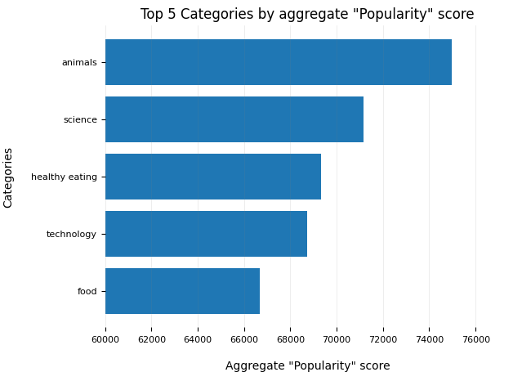
Notes:
From our analysis, you can see that the top 5 most popular categories of posts were animals, science, healthy eating, technology and food in descending order.
Animals had an aggregate popularity score of around 74965. It is very interesting to see both food and healthy eating within the top 5, it really shows that food is a highly engaging content category. Healthy eating ranks slightly higher than food, so perhaps your user base may be skewed towards healthy eaters and health-conscious people.
Finally, its also interesting to see science and technology too. This may suggest that people enjoy consuming factual content and snippets of content that they can learn something from.

Slide 9
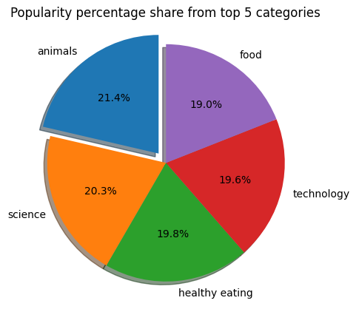
Notes:
Additionally, you can see from this chart the % split of popularity between the top 5 categories. There is not much difference between the share of each category, however, the difference between the 1st most popular, animals and the 2nd most popular, science, is the largest gap equal to 1.1%.
In business terms, this could suggest that the most popular category, animals, is tailing away from the rest of the categories and may continue to get more and more popular. To avoid an issue where 1 content category consumes the entire platform, it will be important for you to ensure that any algorithms used to govern the content on the platform gives a fair balance to the content categories.

Slide 10
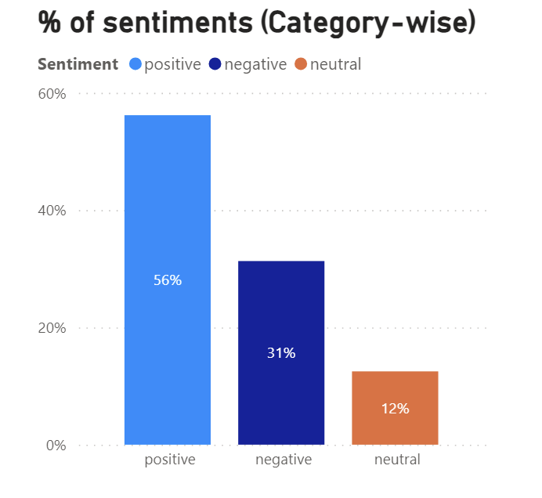
Notes:
This slides shows the percentage of sentiments for the overall categories or data. All the categories contains 56% of positive sentiments overall followed by the 31% negative and the least 12% neutral.

Slide 11
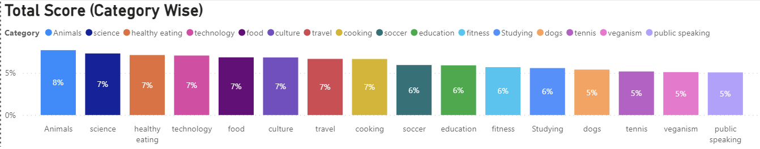
Notes:
This slide shows the percentage of total score category wise. Animal, science, healthy eating, technology and food are the top 5 categories as shown in the graph.

Slide 12

ANALYSIS
Animals and science are the two most popular categories of content, showing that people enjoy "real-life" and "factual" content the most.
INSIGHT
Food is a common theme with the top 5 categories with "Healthy Eating" ranking the highest. This may give an indication to the audience within your user base. You could use this insight to create a campaign and work with healthy eating brands to boost user engagement.
Summary
NEXT STEPS
This ad-hoc analysis is insightful, but it's time to take this analysis into large scale production for real-time understanding of your business. We can show you how to do this.
Notes:
So to summarize:
We tackled this task and found the top 5 most popular categories as asked, but we also went one step further.
- We found that animals and science are the two most popular categories, suggesting that users like "real-life" and "factual" content
- We also found that food was a common theme amongst popular content and the most popular food category was healthy eating. This could be a signal to show the types of people that are using your platform, and you could use this insight to boost engagement even further. For example, you could run a campaign with content focused on this category or work with healthy eating brands to promote content.
- As much as this analysis was insightful, we are ready to take it to the next stage and we have the expertise within Accenture to help you realize these kinds of insights in production across your organization and in real-time. We would love to help you with this.

Slide 13

Thank you!
ANY QUESTIONS?

